Slide 1
Social Acceptability of Body Modifications
Madeleine Sellers

Slide 2
Why I Chose This Topic
“It’ll look ugly when you're old”
Body mods in the job market
Wanted to know more

Slide 3
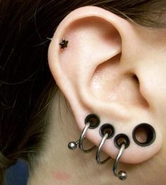
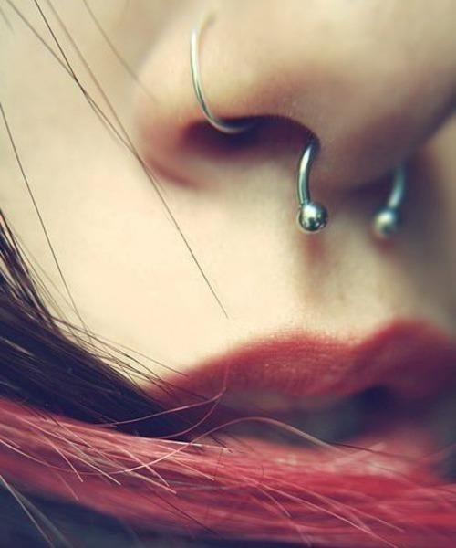
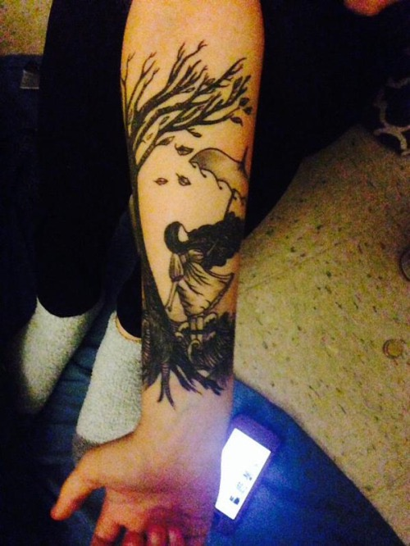
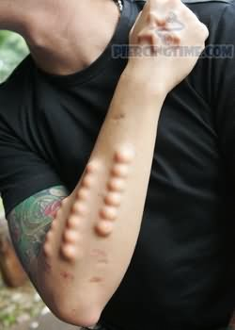
Kinds of Body Mods
Tattoos
Piercings
Flesh Tunnels
Implants

Slide 4
What I Already Knew
40% of Americans have at least one tattoo
Finding a job with body mods can be challenging
People with body mods are often seen as “hoodlums”

Slide 5
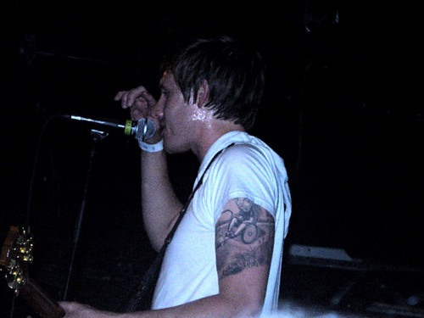
What I Learned
60% of kids under 18 who want body mods are A and B students
People 18-36 are the most “modified” group of people
The next generation is expected to be the most heavily tattooed in history

Slide 6
What I Learned (continued.)
Work places often have “dress codes”
Tattoos are seen as a liability, but can actually be used as an outreach to the community

Slide 7
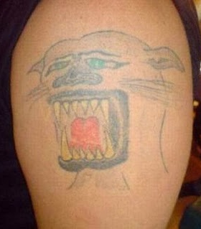
Take Precautions…
Piercings can be fatal
Get body mods done professionally
Most body mods can be/are permanent
Get your tattoos professionally done. Please.

Slide 8
In Conclusion
The social acceptability of body mods is changing, but isn't quite there yet
Body mods are not signs of trouble makers
Body mods are becoming common practice

Slide 9
Works Cited
"History, Travel, Arts, Science, People, Places | Smithsonian." History, Travel, Arts, Science, People, Places | Smithsonian. N.p., n.d. Web. 16 Mar. 2015.
"Job Seekers Still Have To Hide Tattoos (From The Neck Up)." NPR. NPR, n.d. Web. 13 Mar. 2015.
"Stretching (body Piercing)." Wikipedia. Wikimedia Foundation, n.d. Web. 16 Mar. 2015.
"Types of Body Modification." HubPages. N.p., n.d. Web. 16 Mar. 2015.

